Slide 2
SBA Loan Default Prediction
Final Project by Sekar Krismaya Weni
Purwadhika Startup and Coding School

Slide 3
Agenda Style
Introduction
Problem, Goals and Benefit for company
Dataset
Data that used
Data Analyst and Visualization
Insight from the data
Machine Learning
Building Machine Learning using Tree Based Algorithm
Conclusion & Recommendation
Summary & Suggestion for company

Slide 4
Introduction

Slide 5
US Small Business Administration (U.S SBA)
The U.S SBA was founded in 1953 on principle of promoting and assisting small enterprises in the U.S credit market
SBA assists small business enterprises is through a loan guarantee program which is designed to encourage bank to grant loans to small businesses.
SBA acts like an insurance provider to reduce the risk for a bank by taking on some of the risk through guaranteeing a portion of the loan.
In the case that a loan goes into default, SBA then covers the amount they guaranteed
Notes:
- SBA AS didirikan pada tahun 1953 dengan prinsip mempromosikan dan membantu usaha kecil di pasar kredit AS
- SBA membantu usaha kecil melalui program penjaminan pinjaman yang dirancang untuk mendorong bank memberikan pinjaman kepada usaha kecil.
- SBA bertindak seperti penyedia asuransi untuk mengurangi risiko bagi bank dengan mengambil sebagian risiko melalui penjaminan sebagian pinjaman.
- Jika pinjaman gagal bayar, SBA akan menanggung jumlah yang dijaminkan

Slide 6
Problem
The Benefit for Bank and U.S SBA
The default rate for the 10-year period ending in 2008, when nearly 1 in 4 (24.7%) SBA loans weren’t paid back
It means that SBA loan would have loss due to Small Business couldn’t make repayment
In early knowing about the probability of default SBA loan for Small Business, Bank could take an action to prevent it by decrease the loan
Prevent SBA from lossing due to borrower couldn’t make repayment
Goal
Being able to early detected of SBA loan default could reduce the risk of loss for Small Business Administration.

Slide 7
Dataset

Slide 8
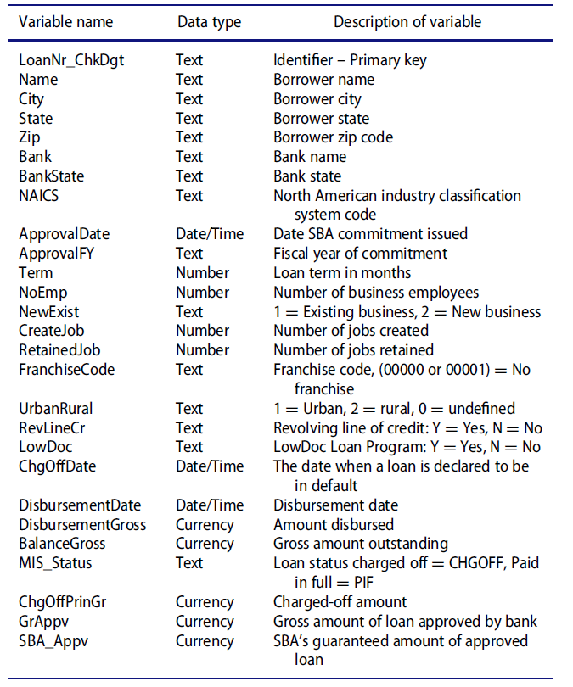
Dataset
The source :
https://www.kaggle.com/mirbektoktogaraev/should-this-loan-be-approved-or-denied
27 Features

Slide 9
Data Analyst and Visualization

Slide 10
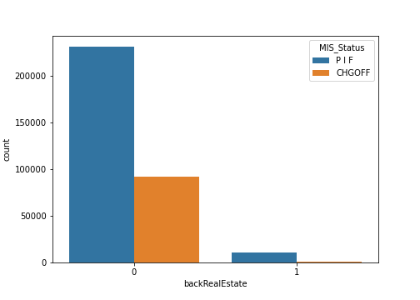
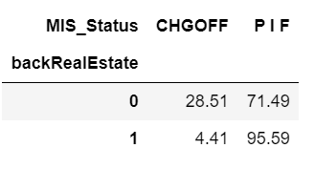
Data Analyst and Visualization
Term and MIS_Status
Loan backed by realEstate has Term >= 240 months
Loan backed by realEstate has lower default
*Term : Loan term in month
*MIS_Status : Loan Status

Slide 11
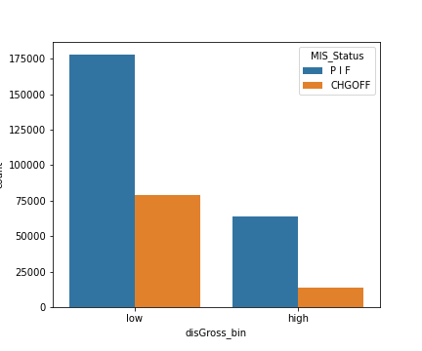
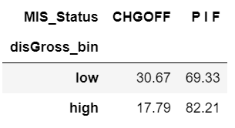
Data Analyst and Visualization
Amount Disbursement and MIS_Status
Low disbursement has higher percentage of Default
*low : Loan up to $150.000
*high : Loan greater than $150.000
*MIS_Status : Loan Status

Slide 12
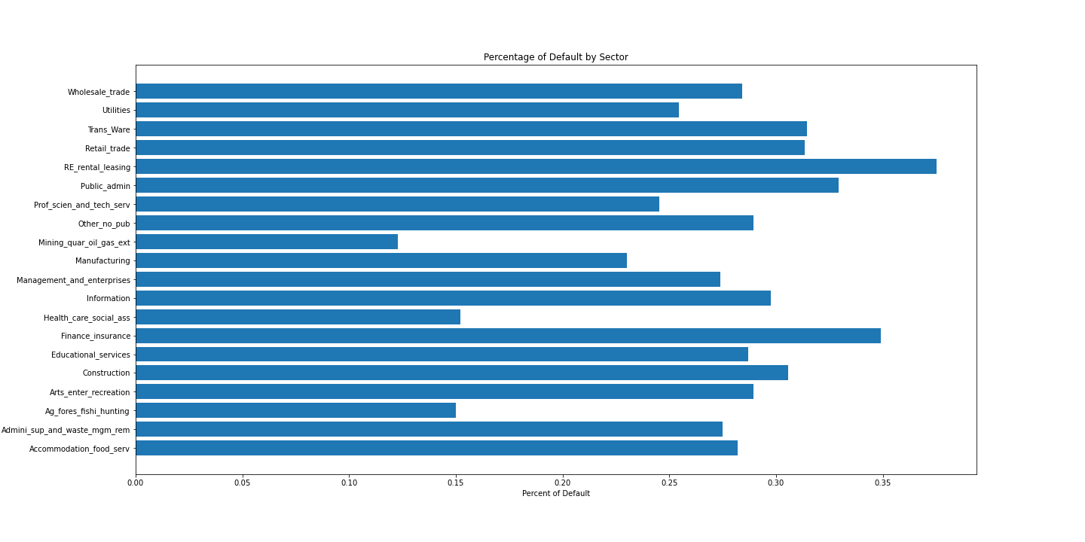
Data Analyst and Visualization
Sector
Real estate and rental and leasing (37.51%) has high percentage of Default
Sector Mining, quarrying, and oil and gas extraction (12.28%) appear to be doing well
*Sector : Base on NAICS

Slide 13
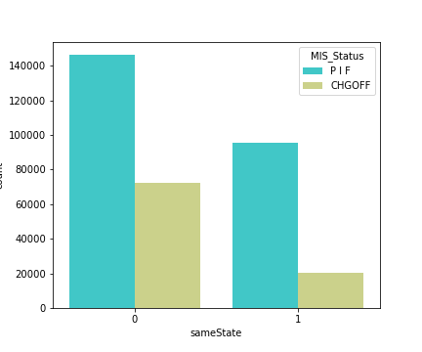
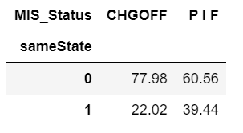
Data Analyst and Visualization
sameState and MIS_Status
Small Business that has different State with lender tend to has high risk
*sameState : location between lender and small business
*MIS_Status : Loan Status

Slide 14
Some Insight from Data Analyst and Visualization
Percentage of borrower who pain in full (PIF) around 72.33% while borrower who charge off around 27.67%
Loan backed up by real estate has lower CHGOFF (4.41%) rather than not backed up by real estate (28.51%)
Whether the business was Existing Business or New Business, both of them has same risk of CHGOFF
Most of CHGOFF come from Urban with percentage 86.24%
Small busines with revolving line of credit has lower risk of default loan with percentage 26.26%
Mostly for small business that has default loan (CHGOFF) didn't come from LowDoc. The percentage of LowDoc that CHGOFF only 15.44%
CHGOFF with low DisbursementGross has higher percentage 30.67% rather than high DisbursementGross. Its means that mostly CHGOFF come from small business with low DisbursementGross

Slide 15
Some Insight from Data Analyst and Visualization
Year with highest number of loan was 2007 (17.07%), followed by 2006(16.64%) and 2005(14.15%)
Year where has highest Percentage of default loan was 2008 (46.41%), followed by 2007(46.02%)
Mostly small business that CHGOFF come from different State with percentage 77.98%
Agriculture, forestry, fishing and hunting has highest mean of Portion that SBA guarantee
Sector Feature
Retail trade and Manufacturing has significantly loan disbursement compare to another sector
Mining, quarrying, and oil and gas extraction has highest median of Gross amount of loan approved by bank around 100000.0, followed by Agriculture, forestry, fishing and hunting
Sector that has highest default was Real estate and rental and leasing (37.51%), followed by Finance and Insurance (34.91%) and Transportation and warehousing (31.44%)

Slide 16
Machine Learning

Slide 17
Machine Learning
Algorithms based Tree
Decision Tree
Random Forest
XGBoost

Slide 18
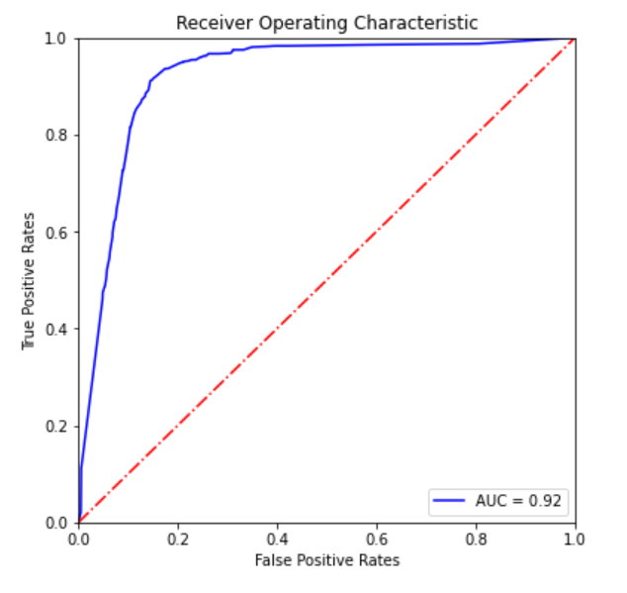
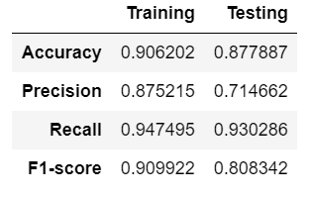
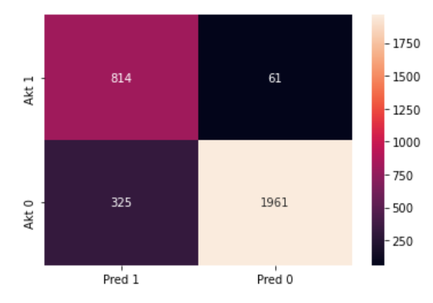
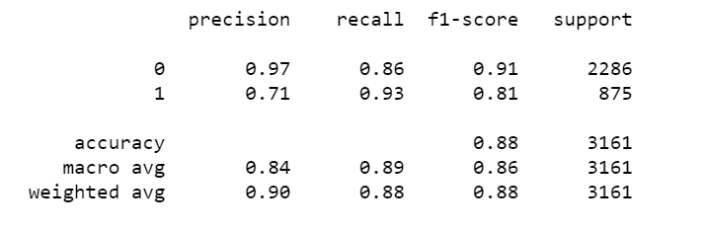
Evaluation Matrix Random Forest Tuned
ROC_AUC
Confussion Matrix Random Forest Tuned
Classification Report Random Forest Tuned

Slide 19
Conclusion

Slide 20

Conclusion
Here are some conclusion that should become concern on to reduce the risk of default from Data Analyst:
Small Business that has Term of loan less than 240 month tend to has high risk of default. The percentage reach 28.51%.
Small Business with low amount disbursement tend to has high risk of default. The percentage reach 30.67%.
Small Business that come from sector Real estate and rental and leasing has high risk of default with percentage reach 37.51%
Small Business that come from different State tend to has high risk of default. The percentage reach 77.98%.
Here are some conclusion from Building Model :
- Random Forest Tuning has good Recall around 0.93
Receiver Operating Characteristic has value 0.89. It means that model good enough to separate the target (CHGOFF or PIF)
Notes:
SBA also overhauled the SBAExpress procedures and increased the maximum maturity for revolving lines of credit under SBAExpress from 7 to 10 years. SBA added a provision for the orderly repayment that SBA Express LOCs may revolve for no more than 60 months, with a term out period of up to another 60 months, for a total term of 120 months, and under no circumstances may there be any advances under the line of credit after the initial 60 month period.
Once the SBA Express loan is termed out (becomes a term loan as opposed to a line of credit), the lender may issue a new line of credit to the borrower to assist their short-term/revolving W/C needs.
SBA also clarified that increases to SBAExpress loans which are originated as a LOC may only be increased during the draw period.

Slide 21
Recommendation
Here are some suggestion to reduce the risk of default:
Small Business with low amount disbursement, term less than 240 month, and come from sector Real estate and rental and leasing should more get attention by lender. Lender could recommend counseling to Business owners through SBA Program to make reduce the risk of default in future.
Lender should more pay attention to Small Business location to prevent default due to different State. When the borrowers has different State with Lender, lender could offer another lender that has same State.
Recommendation for Modelling:
Try to use machine learning algorithms base distance
Try another way to handling Imbalance Data

Slide 22
Thank you

